Slide 1
Sturgeon Bay Board of Education 2-19-14
A community-based initiative that advances
the cause of civility in everyday life to
strengthen our shared community.

Slide 2
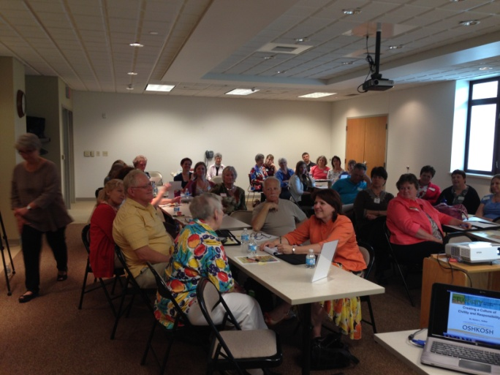
Door County Civility Project
History:
1997 - Dr. P.M, Forni of Johns Hopkins University authors Choosing Civility and The Civility Solution
2003 Duluth-Superior Area Community Foundation’s Civility Project: “Speak Your Peace”
2010 Oshkosh Civility Project
2013 Door County Civility Project
2013 Door County Civility Project becomes an affiliate of the Wisconsin Civility Project
Door County Civility Workshop – June 2013
Other Wisconsin counties & communities supporting CIVILITY efforts:
Appleton WI Rapids Douglas Co
Southern Wood Co Evansville Town of Hull
Winnebago Co Jefferson Co Muskego
Stevens Point Schools Superior
Racine Oshkosh Schools Town of Sturgeon Bay
Town of Liberty Grove City of Sturgeon Bay

Slide 3
Civility isn’t a new idea!
“Every action done in company, ought to be with some sign of respect, to those that are present.”
- George Washington, age 16, Rule #1 , 110 Rules of Civility and Decent Behavior

Slide 4
Roles & Responsibilities…
Addressing educational issues is
a community-wide responsibility and activity - elected officials, citizens, and community organizations, as
well as school staff
all have roles and responsibilities.

Slide 5
Why the School Board?
A civil atmosphere makes it possible for all to thoughtfully and effectively talk about, learn about, consider and leverage a wide range of ideas and perspectives by all involved regarding the challenges the district faces.
When you as leaders talk effectively amongst yourselves, it helps you use meeting time wisely and can improve the quality of your decision-making...solutions may be found which otherwise may not have surfaced.

Slide 6
Why Sturgeon Bay School Board?
The Tools of Civility support your district’s mission statement –
“THE DEVELOPMENT OF INFORMED, KNOWLEDGEABLE CITIZENS AND SUCCESSFUL LIFE-LONG LEARNERS.”
The Tools of Civility support your school’s efforts in PBIS to have schools where everyone is safe, respectful and responsible!
You can help civility branch out to student, parent and staff groups within Sturgeon Bay Schools and other groups in the Sturgeon Bay community.
Civil actions can be as contagious!

Slide 7
Speak Your Peace – The Nine Tools of Civil Behavior
Insert our poster
“It’s not what you say but how you say it” is a classic statement.
The DC Civility Project believes civility is both –what you say AND how you say it! Recognize the power of your words!

Slide 8
1. Pay Attention
Every act of kindness is first of all, an act of attention.
Avoid automatic pilot; you are not attending just to a person, but this person.
Be in the present moment.
Sharpen your antenna!

Slide 9
2. Listen
Much of the conflict in our lives can be explained by one simple but unhappy fact: we don’t really listen to each other.

Slide 10
3. Be Inclusive
Diversity of people, thoughts, opinions, and ideas, help us achieve a broader dimension of ourselves as individuals and communities.
Remember to “Invite the Stranger.”

Slide 11
4. Don’t Gossip
Don’t discount the power of your words.
Speaking with consideration and kindness is at the heart of civil behavior.
“Nobody ever gossips about other people’s secret virtues." – Bertrand Russell

Slide 12
5. Show Respect
Honor other’s time and physical space.
Respect includes recognizing that others are entitled to look at the world differently.
Recognize and honor other’s good intentions.

Slide 13
6. Be Agreeable
Two key ingredients for being agreeable in conversation:
* The ability to consider
that you might be wrong.
*The ability to admit that
you don’t know.
“To disagree, one doesn’t have to be disagreeable”
- Barry Goldwater

Slide 14
7. Apologize
It is courageous and humbling to admit fault.
Be genuine and your message heartfelt.
Keep it simple:
“I’m sorry.”
Work to repair damages!

Slide 15
8. Give Constructive Criticism
Sharing an opposing point of view is a civic responsibility--
“If not I, who?
If not now, when?”
Intention must be to help, not to humiliate.

Slide 16
9. Take Responsibility
Don’t pretend something didn’t happen; own your behavior.

Slide 17
Our Challenge…
It is easy, yes… so easy,
to be civil with people
who agree with you
and those who think
like you do!
The challenge is to be civil with those who strongly disagree with you and do not share your opinions!

Slide 18
The Door County Civility Project…
Is NOT a campaign to end all disagreements … but a campaign to make it safe to disagree.
- It is quite possible to be true to one’s beliefs and be civil at the same time.
Is NOT about perfection… it is about making a conscious commitment to actively pursue improvement.
- We do not intend to be the “civility police”.

Slide 19
What Can You Do?
Individually commit to civility (sign the pledge) and model civil behavior.
Join other school districts in Door County endorsing civility and promote the use of the tools of civility for all groups in your district.
Post the Door County Civility posters in your district’s meeting rooms, classrooms and hallways.
Invite the Door County Civility Project to present to other groups in your district and community and/or provide more in-depth training.

Slide 20
Major Supporters and Financial Donors
League of Women Voters®
of Door County
The DCCP accepts donations through the Door County Community Foundation!
MIDWEST WIRE PRODUCTS LLC
“ISO 9001:2008 CERTIFIED”

Slide 21
Just Say YES to Civility!
Website: DoorCountyCivilityProject.org
WisconsinCivilityProject.org
‘Like’ us: Facebook “DC Civility Project”
Email: dccivilityproject@gmail.com

