Slide 1
Speak Your Peace Tool 5 - Show Respect
.
CIVILITY in our places of work
and our organization

Slide 2
Just Say YES to Civility!
Website: DoorCountyCivilityProject.org
WisconsinCivilityProject.org
‘Like’ us: Facebook “DC Civility Project”
Email: dccivilityproject@gmail.com
Phone: 920-746-1786

Slide 3
SHOW RESPECT Banners have been given to Door County High Schools for gyms and athletic fields with support from a Raibrook Grant, Rotary Clubs and other donations.

Slide 4
Speak Your Peace The Nine Tools of Civil Behavior
Insert our poster
The focus of this presentation is Tool 5
Show Respect
What does respect mean to you?
Notes:
]

Slide 5
How the Experts Define Civility
How we implement respect
How we communicate respect through our words, body language, and behavior
Requires self-control, awareness, work, practice!
We COMMUNICATE our CHARACTER
by how we exercise CIVILITY!

Slide 6
Respect means…
Respect means that you accept somebody for who they are, even when they're different from you or you don't agree with them.
Respect in your relationships builds feelings of trust, safety, and wellbeing.
Respect is a way of treating others… even when you may not like them!

Slide 7
Respect
“I'm not concerned with your liking or disliking me... All I ask is that you respect me as a human being.”
- Jackie Robinson

Slide 8
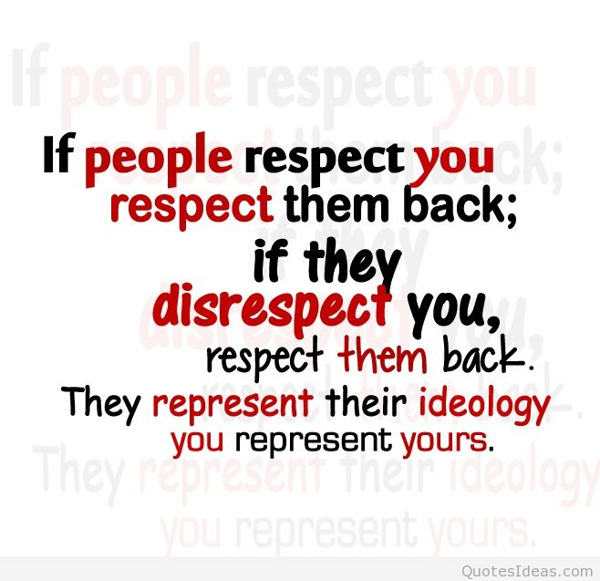
Show Respect

Slide 9
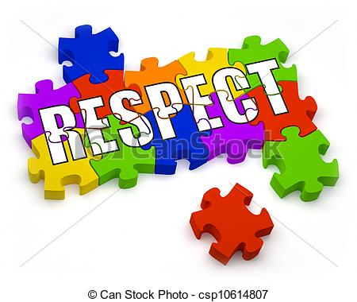
RESPECT is intertwined with all of the other tools of civility
Are we showing respect
when not paying attention?
when not listening?
when we are not being inclusive?
when we gossip?
when we are being disagreeable?
when we do not apologize for wrong doing?
when we are not constructive with criticism?
when we do not take responsibility?

Slide 10
7 Ways to Be Respectful – Girl Scouts
1. Listen and be present
2. Be thoughtful of others’ feelings
3. Acknowledge others and say thank you
4. Address mistakes with kindness

Slide 11
7 Ways to Be Respectful – Girl Scouts
5. Make decisions based on what’s right, not who you like
6. Respect physical boundaries
7. Live and let live
- Talk about integrity!

Slide 12
Rotary 4-Way Test
Is it the TRUTH?
Is it FAIR to all concerned?
Will it build GOODWILL and BETTER FRIENDSHIPS?
Will it be BENEFICIAL to all concerned?
These demonstrate RESPECT!

Slide 13
How were you taught to respect others? Honor others?
Honor other’s time and physical space.
Respect includes recognizing that others are entitled to look at the world differently.
Recognize and honor other’s good intentions.

Slide 14
Respect is
believing everyone has value and acting accordingly.

Slide 15
Just Say YES to Civility!
Website: DoorCountyCivilityProject.org
WisconsinCivilityProject.org
‘Like’ us: Facebook “DC Civility Project”
Email: dccivilityproject@gmail.com
Phone: 920-746-1786

