Slide 1
Overview of Door County Civility Project & Speak Your Peace Tool 1 - Pay Attention
.
CIVILITY in our places of work
and our organization

Slide 2
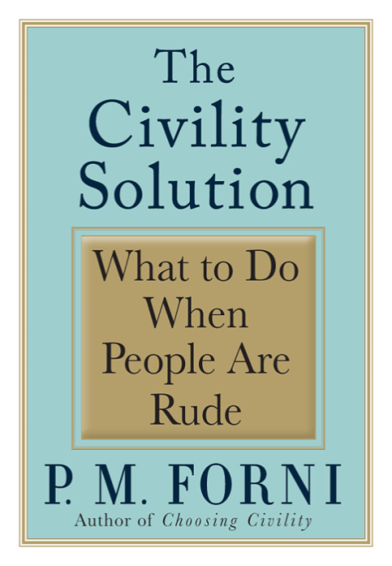
Door County Civility Project
1997 Dr. P.M, Forni
of Johns Hopkins University authors Choosing Civility and The Civility Solution
2003 Duluth-Superior Area Community Foundation’s Civility Project: “Speak Your Peace”

Slide 3
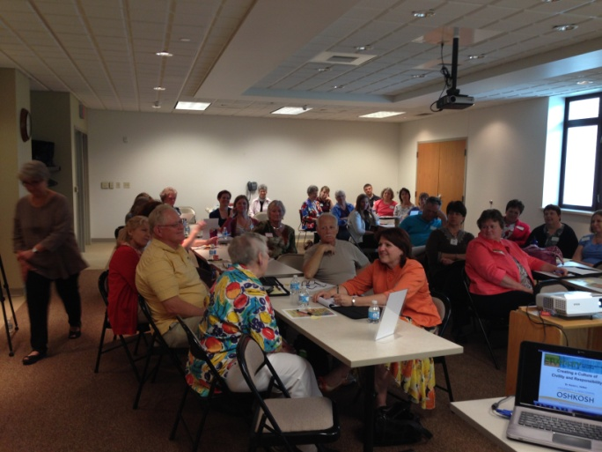
Door County Civility Project
2010 Oshkosh Civility Project
2013 Door County Civility Project
2014 Truckee Tahoe Civility Project
Mission:
A community-based initiative
that advances
the cause of civility in everyday life to
strengthen our shared community.

Slide 4
CIVILITY
How do you define it?

Slide 5
Civility Defined…
Civility is complex.
Civility means weaving together restraint, respect and responsibility as we interaction with others.
Civility belongs in the realm of ethical and of moral behavior.
Respect for others Listening
Care Good citizenship
Consideration Peace
Courtesy Community service
The Golden Rule Abiding by rules
Politeness Moderation
Maturity Awareness
Kindness Equality
Manners Compassion
Fairness Self control
Justice Tact
Honesty Trustworthiness
Sincerity Being agreeable
Being accommodating

Slide 6
How the Experts Define Civility
How we implement respect
How we communicate respect through our words, body language, and behavior
Requires self-control, awareness, work, practice!
We COMMUNICATE our CHARACTER
by how we exercise CIVILITY!

Slide 7
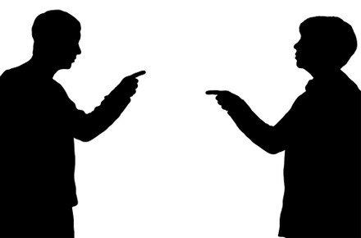
Our Challenge…
It is easy,
(yes so easy)
to be civil with people
who agree with us
and those who think
like we do!
The challenge is to be civil with those who strongly disagree with us and do not share our opinions!

Slide 8
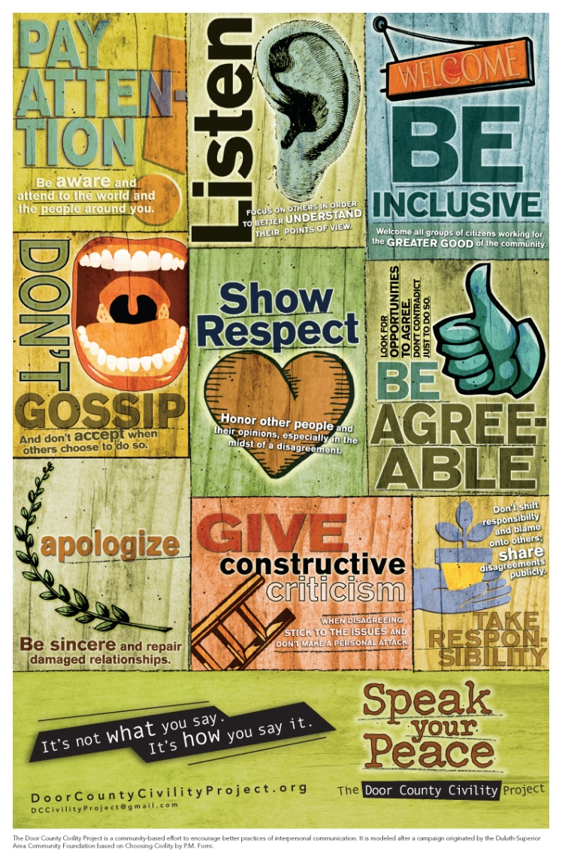
Speak Your Peace The Nine Tools of Civil Behavior
Insert our poster
This presentation focuses on Paying Attention.
What does paying attention mean to you?

Slide 9
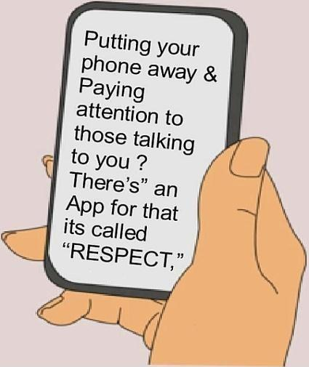
Pay Attention
Read more in Reclaiming
Conversation - the Power of
Talk in a Digital Age by Sherry Turkle

Slide 10
“Paying attention means to be sufficiently present with a person, an idea, or a situation so that you get the internal and external information you need to decide and act wisely.” Still Point Leadership 2013
Many of our actions are about producing results, making some difference in our family, community, workplace, the world. Our results flow from our decisions and actions.
And yet, too many of us don’t get crucial information, either from our gut or from the environment around us. We’re not sufficiently present. We’re not paying attention.

Slide 11
And the consequence?
We make choices that don’t produce the results that we want or are inconsistent with what’s important to us, and we miss opportunities for connection with the people around us.
Anyone that consistently misses important information, or who is so distracted that she’s not connected to the people around her, will not be effective for long.

Slide 12
Humans have five basic senses: sight, hearing, smell, taste and touch that are our pathways for receiving information.

Slide 13
Attention looks two ways – outwards and inwards.
Outward attention –
To be thoughtful or empathetic to others ,
you need to first notice how they are feeling.
Be with them here and now and not lost in your own thoughts, judgments or agenda.

Slide 14
Attention looks two ways – outwards and inwards.
Inward self-attention
– noticing the moment of anger or hurt –
and taking a deep breath before acting from that emotion.
Recent research indicates that by taking 3 breaths prior to speaking when upset… our words will words will come out more as we intend them to.
- Dealing With Difficult People, 2020

Slide 15
How do you show someone that you are really attending to them?
- What expressions do you use? What non-verbal
behaviors do you show?
How important is eye contact in your communication with others?
What differences have you noticed between how men and women deal with eye contact?
There are also cultural differences regarding appropriate eye contact.

Slide 16
Step 1 Prepare yourself to pay attention. - Decide to pay attention; set an intention to be present. - Clear your mind. Eliminate distractions. Do a “brain dump” to get distracting ideas out of your head. Try to not overschedule. -
Four Steps to Practice Paying Attention
- Still Point Leadership https://stillpointleadership.com/paying-attention/

Slide 17
Step 2 Direct your attention. - Know what it is you want to pay attention to. - Practice “single-tasking”. -
Four Steps to Practice Paying Attention

Slide 18
Step 3 Sustain your attention. - Do your best to keep your attention where you’ve placed it. - Question actively, but appropriately.
Four Steps to Practice Paying Attention

Slide 19
Step 4 Live a life that supports you in paying attention. - slowing down occasionally - quieting your body and mind - taking care of yourself -
Four Steps to Practice Paying Attention

Slide 20
But paying attention is a skill cultivated over time, especially in the fast-paced world we live in. Remind yourself of the ‘why’. What will you do to practice ‘paying attention’ today?
TIME
&
PRACTICE

Slide 21
How do you feel when someone is not paying attention to you? Do you let them know? How? What do you say?
Identify a specific time when you failed to pay attention. How did that impact another person? What were the consequences for you?

Slide 22
Pay Attention - Summary
Every act of
kindness
is first of all,
an act of
attention.
Avoid automatic pilot; you are not attending just to a person,
but this person.
Be in the present moment.
Sharpen your antenna!

Slide 23
Just Say YES to Civility!
Website: DoorCountyCivilityProject.org
‘Like’ us: Facebook “DC Civility Project”
Email: dccivilityproject@gmail.com
Phone: 920-746-1786

