Slide 1
Speak Your Peace Tool 3 - Be Inclusive
.
CIVILITY in our places of work
and our organization

Slide 2
Just Say YES to Civility!
Website: DoorCountyCivilityProject.org
WisconsinCivilityProject.org
‘Like’ us: Facebook “DC Civility Project”
Email: dccivilityproject@gmail.com
Phone: 920-746-1786

Slide 3
Speak Your Peace The Nine Tools of Civil Behavior
Insert our poster
The focus of this presentation is Tool #3
Be Inclusive
What does being inclusive mean to you?

Slide 4
Diversity Inclusion
Measureable
Statistics
Can be analyzed
Can be tracked
i.e. numbers in terms of race, ethnicity, gender, lgbtq+, disability, etc.
Mindset
Feeling
Way of life
How one acts
How one speaks
How one thinks
Culture of a group

Slide 5
There are many differences
Young adult
Native to DC
Political
New at the job
Religious
LGBTQ
Poor
Black or brown
Older adult
Moved to DC
Non-political
Experienced at the job
Not religious
Straight
Wealthy
White

Slide 6
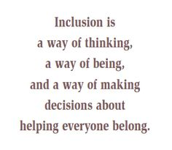
Be Inclusive

Slide 7
Be Inclusive – Reflect on your peronal experiences
What is an early memory of race?
Or what is a powerful memory of race?
Was it your experience or someone else’s?
Was that memory a positive or negative experience for you?
How does that memory impact you now?

Slide 8
Be Inclusive
Were conversations about race a part of your upbringing?
If so, how was the subject approached?
How does race impact your daily life now?

Slide 9
Moves to Becoming More Inclusive
Recognize Your Unconscious Bias—and Be Humble About It
Make the Unwritten Rules Obvious
Don’t Overlook the “Small” Stuff
Understand the Advantages You’re Born With
Believe That People Are Created Equal, But Not The Same

Slide 10
Moves to Becoming More Inclusive
6. Amplify more voices.
7. Promote accessibility.
8. Be mindful in your communication. (micro-aggression)
9. Use inclusive language.
10. Expose yourself to counter-stereotyping imagery.

Slide 11
11. Share
12. Initiate
13. Empathize
14. Host Informal Gatherings
15. Write Thank You Notes
16. Read/Study
Moves to Becoming More Inclusive

Slide 12
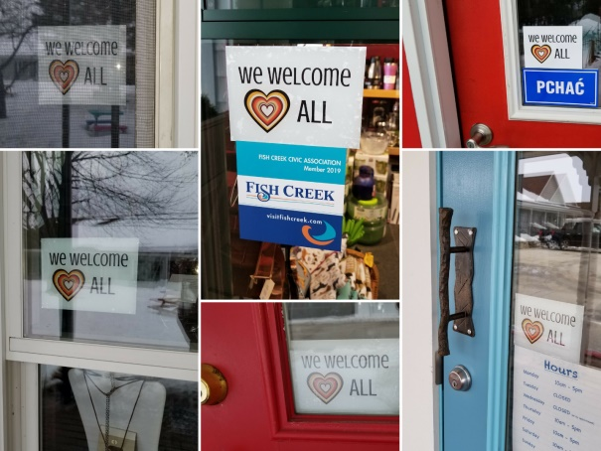
What else?
Local:
We Welcome All initiative
DC Civility Project
Just Door County
State:
Proposed Legislation –
Criminal Justice Reform
National:
Legislation - FIRST STEP Act
BLM Movement
Local, State and
National
governments
and groups are working to address this?

Slide 13
Be Inclusive
Diversity of people, thoughts, opinions, and ideas, help us achieve a broader dimension of ourselves as individuals and communities.
Remember to “Invite the Stranger.”

Slide 14
Parker Palmer…
In Healing the Heart of Democracy, Parker Palmer says:
“The civility we need will not come from watching our tongues. It will come from valuing our differences.”
Do you agree? Disagree?
Why?

Slide 15
Just Say YES to Civility!
Website: DoorCountyCivilityProject.org
WisconsinCivilityProject.org
‘Like’ us: Facebook “DC Civility Project”
Email: dccivilityproject@gmail.com
Phone: 920-746-1786

