Slide 1
Speak Your Peace Tool 6 - Be Agreeable
.
CIVILITY in our places of work
and our organization

Slide 2
Just Say YES to Civility!
Website: DoorCountyCivilityProject.org
WisconsinCivilityProject.org
‘Like’ us: Facebook “DC Civility Project”
Email: dccivilityproject@gmail.com
Phone: 920-746-1786

Slide 3
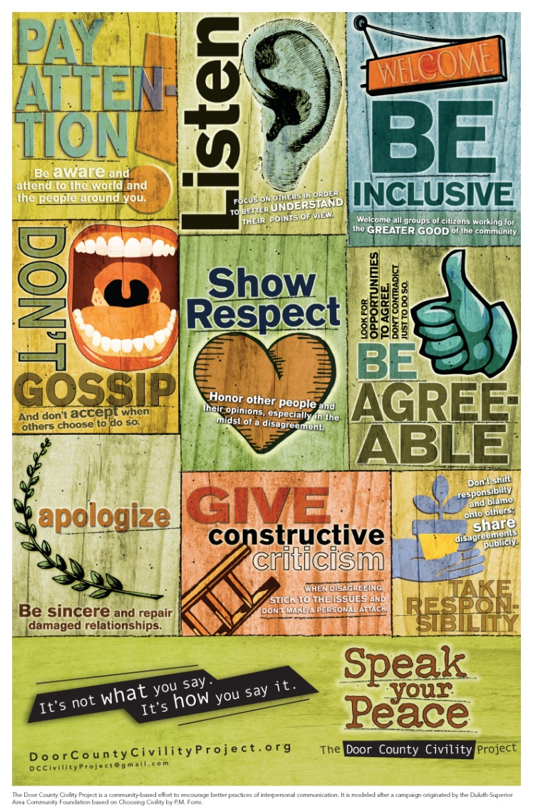
Speak Your Peace The Nine Tools of Civil Behavior
Insert our poster
The focus of this presentation is Tool 6 -
Being Agreeable
What does ‘being agreeable’ mean
to you?

Slide 4
Agreeable People
People with this skill
look for the common good in others,
are quick to hear out opinions of the people around them, and
looks for harmony instead of discord.

Slide 5
Agreeable vs Disagreeable –
Agreeable
Don’t insult others
Don’t question a person’s motives or intentions
Don’t think that they are better than others - everyone is their equal
Disagreeable
Less amenable and more combative person
More inclined to be manipulative, callous, aggressive, and competitive.
Source - Psychology Today

Slide 6
Agreeable vs Disagreeable –
Agreeable
Quick to empathize and respect others.
Complain less
Are less rigid
Are more trusting and forgiving.
Disagreeable
Don’t care much about other people
Make disparaging or offending comments
Have little patience; are easily irked and annoyed.
Source - Psychology Today

Slide 7
Can you become more agreeable?
Research shows
People become more emotionally stable, more conscientious and more agreeable in their later years.
Exposure to positive role models who demonstrate highly agreeable qualities can make a person more agreeable.
Living through the hardship of life can make a person more agreeable. Source - Psychology Today

Slide 8
Can you become more agreeable?
Being in situations where agreeableness is important (such as in a job which involves collaboration, team effort and partnership) can make a person more agreeable.
Increased self awareness of words and actions and intention to be more agreeable can be successful.
Experiencing opportunities to behave in an altruistic manner can influence one to be more agreeable.

Slide 9
Be Agreeable
Two key ingredients for being agreeable in conversation:
* The ability to consider
that you might be wrong.
*The ability to admit that
you don’t know
everything!
“To disagree, one doesn’t have to be disagreeable”
- Barry Goldwater

Slide 10
Be agreeable is not the same as agreeing!
Consider if you want to thoughtfully air and resolve an issue or do you want to crush the other party?’
Recognize the difference between fact and opinion. Present your thoughts as opinions; check your facts as truths.
Try for qualified disagreement: “Yes, and if you look at it from a different point of view…”
Ask “What do you think?”
Know when to hold your tongue!

Slide 11
Can you be too agreeable?
Too agreeable? You may get stepped on like a doormat.
Agreeable people sometimes suffer when they put the needs of others over their own.
Giving in to an argument just to remain friendly doesn’t always result in the best outcome.
Certain situations demand less congeniality, like managing financial negotiations or other potentially discomforting scenarios.

Slide 12
Being agreeable is not being a pushover!
Be direct.
Simply communicate what you think or feel about some thing. Be objective and reasonable.
Don’t be afraid to say no.
We have necessary obligations we can’t reject. We often convince ourselves that certain tasks are obligatory when they don’t have to be.
Embrace your accomplishments
A simple “thank you” will do.
Don’t Catch Other People’s Stress
We can’t expect people to not bring their stress to us, but we don’t have to accept it.

Slide 13
Being agreeable ‘online’ is
Using social media to connect and communicate, instead of to complain!

Slide 14
Social Media Can Hold a Remedial Responsibility
Post more positive things regarding things we see happening.
Flag information that is uncivil.
Expect social media companies to take a serious look at uncivil behavior.

Slide 15
Setting boundaries for yourself may help others do the same.

Slide 16
Is
‘agreeableness’
contagious?
Being agreeable can rub off on people -
seeing a person getting along and doing good can perpetuate kindness and charity toward others.
In a sense, the agreeable end up paying compassion forward!

Slide 17
Just Say YES to Civility!
Website: DoorCountyCivilityProject.org
WisconsinCivilityProject.org
‘Like’ us: Facebook “DC Civility Project”
Email: dccivilityproject@gmail.com
Phone: 920-746-1786

