Slide 1
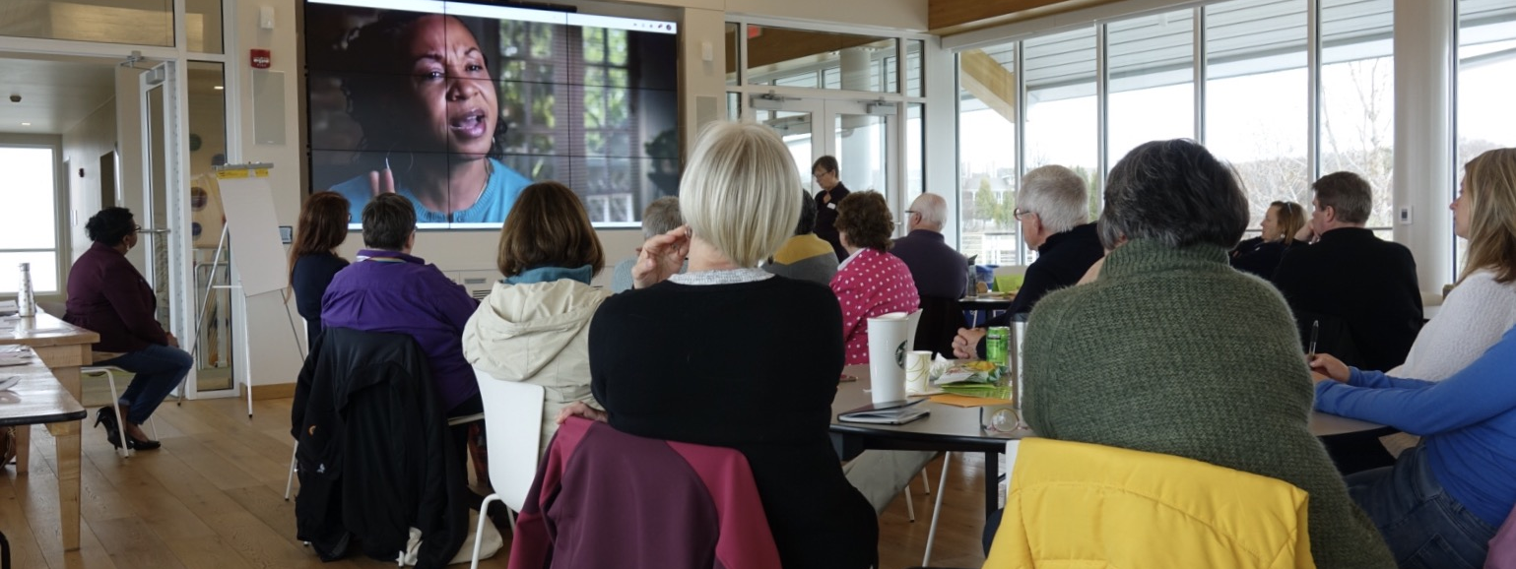
Get to know you:
Community action
Door County PFLAG Door County JUST Door County, Inc.
Civility Project

Slide 2

Door County
Civility Project
Mission:
A community-based
initiative that advances
the cause of civility
in everyday life
to strengthen
our shared community.

Slide 3


Slide 4
Inclusion
Diversity of people, thoughts, opinions, and ideas, help us achieve a broader dimension of ourselves as individuals and communities.

Slide 5
Fostering a culture of openness and inclusion is in the best interest of everyone.
It may not be useful to be surrounded by those who all think alike…there is a loss of synergy and creativity and the risk of “groupthink”.
One of our strongest human yearnings is to be accepted by others - thus attitudes and words that exclude are incredibly hurtful.

Slide 6
Make being an ally a verb!
Demonstrate that you want to help change the world for marginalized communities even if you are not part of a particular group
Demonstrate that that you understand views different from your own
Do something – influence change!

Slide 7





The civility we need will not come from simply watching our tongues, but from valuing our differences.
– Parker Palmer

Slide 8

Just Say YES to Civility!
Our steering committee meets quarterly!
(next – Friday, 12/6, 8-9:30)
We invite representation from your organization at our meetings.
Website:
DoorCountyCivilityProject.org
Facebook:
“DC Civility Project”
Email:
dccivilityproject@gmail.com

Slide 9

PFLAG
Our mission is to build on a foundation of loving families united with LGBTQ+ people and allies who support one another and to educate ourselves and our communities to speak up as advocates until all hearts and minds respect, value and affirm LGBTQ+ people.

Slide 10

Our Vision
PFLAG envisions a world where diversity is celebrated and all people are respected, valued, and affirmed inclusive of their sexual orientation, gender identity, and gender expression.

Slide 11
By meeting people where they are and collaborating with others, PFLAG realizes its vision through:
Support
Education
Advocacy

Slide 12

PFLAG – Door County was formed in 1997 because a local young gay man thought he was alone and was considering suicide.
Since then, PFLAG has met monthly knowing that even one supportive person can prevent a suicide!

Slide 13
Support Meeting Schedule
Sturgeon Bay - Meets the 3rd Sunday of each month, 5:00 PM at Hope Church – at 12th and Michigan
Ephraim - Meets the 2nd Thursday of each month, 6:00 PM at the Unitarian Universalist Fellowship located at 10341 Water St. (Hwy 42) between Ephraim and Sister Bay, just south of the Shops of the Green Gables (September to May)
The meetings are FREE, confidential, informal,
led by volunteers and usually last about an hour.

Slide 14
PFLAG Door County
PFLAG Door County maintains a 24/7 phone to provide support and resources to any caller.
Call 920-421-8814
Email pflagsturgeonbay@gmail.com
Visit our website http://pflagdoorcounty.org/
Join our group on Facebook!
We also publish a monthly newsletter. You can subscribe on our website!

Slide 15


Slide 16


Slide 17
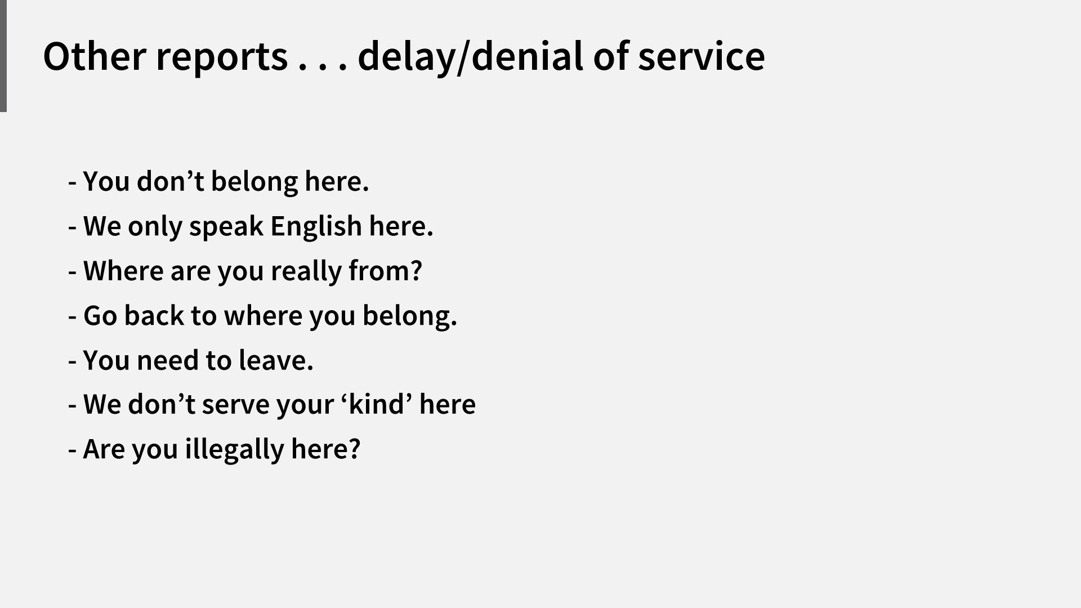

Slide 18
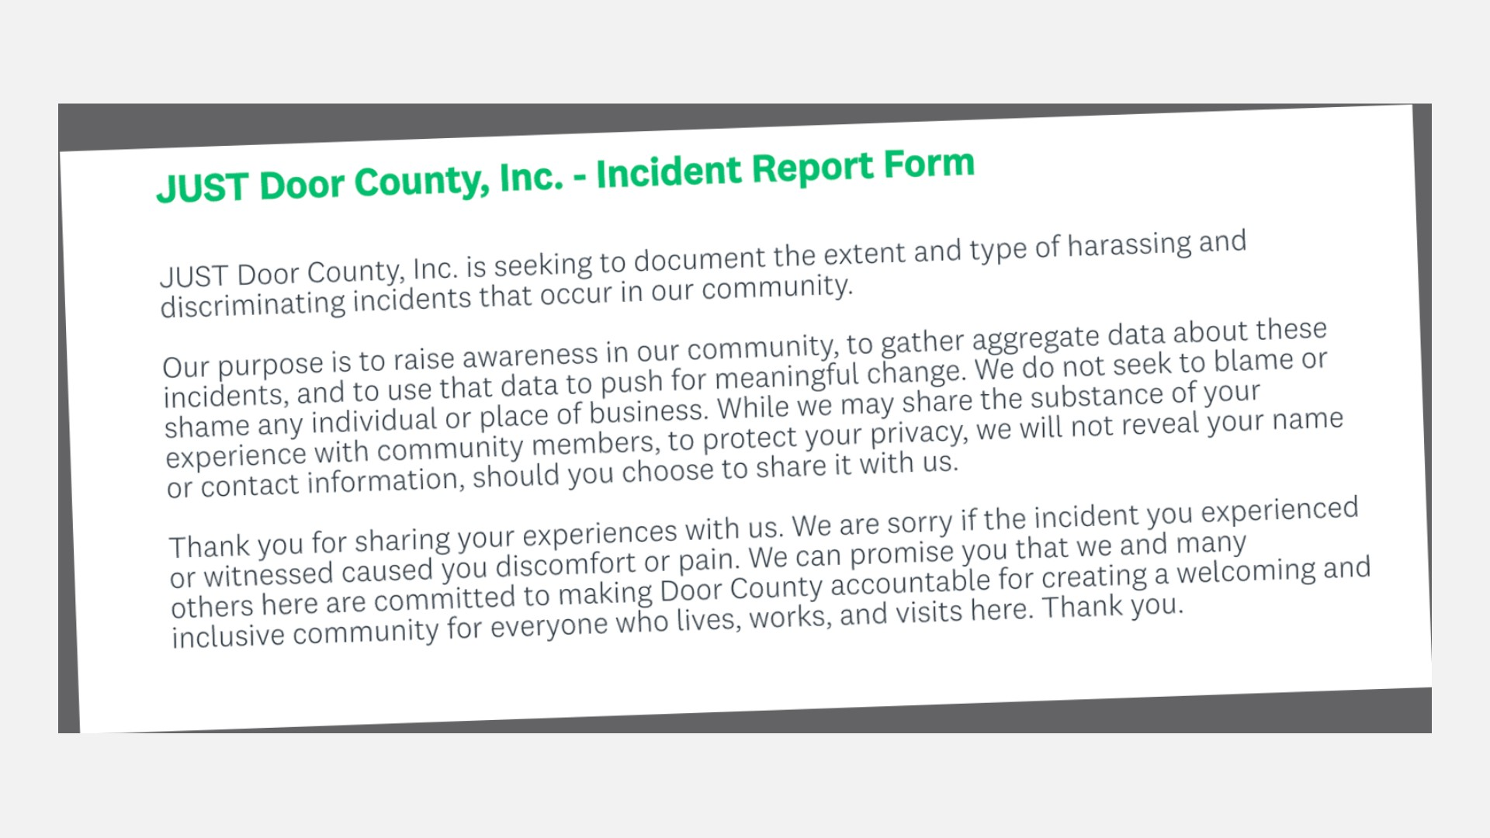

Slide 19


Slide 20
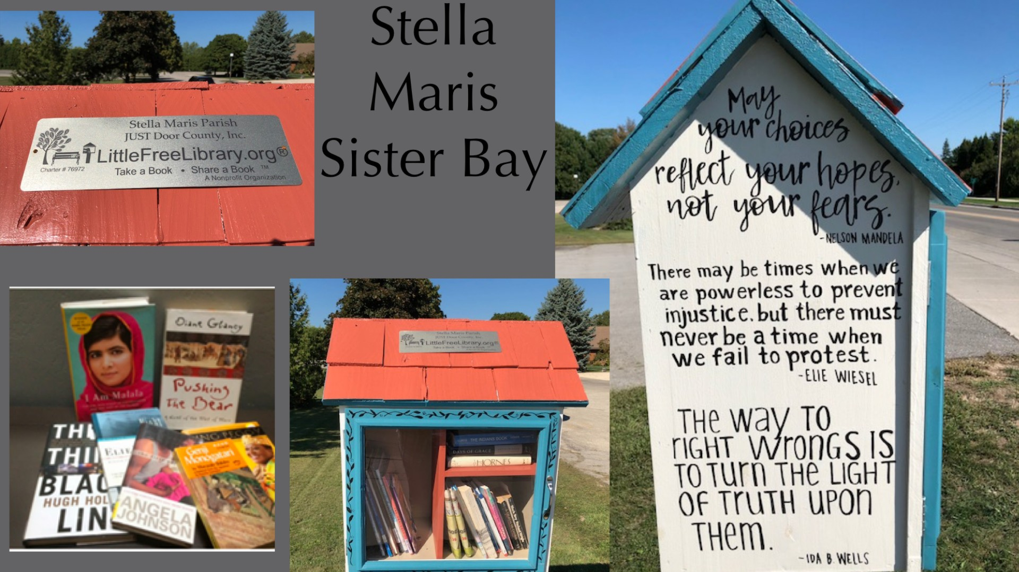

Slide 21
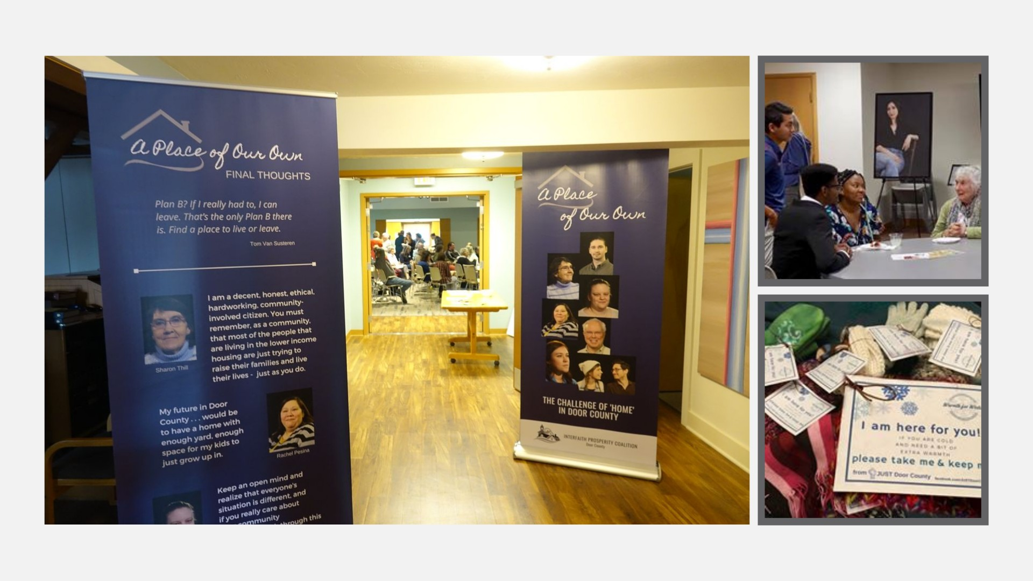

Slide 22


Slide 23
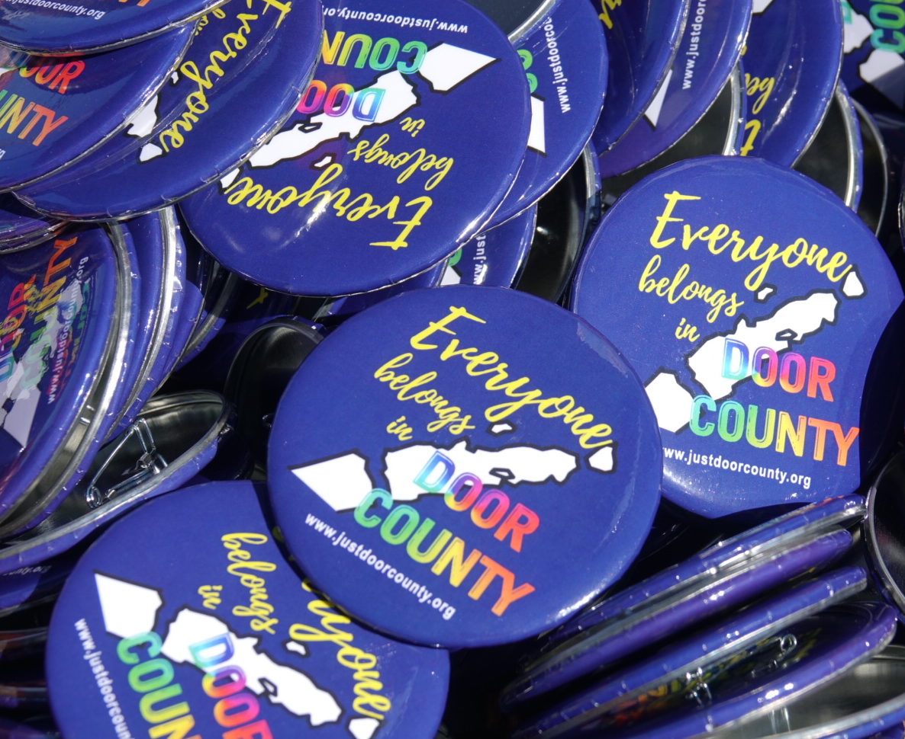
What is INCLUSION?
Creating an environment so that each individual who lives, works, or visits in Door County is a respected and valued member of our community.

Slide 24
Inclusion
A conscious choice
A process, not just a program
Acknowledges, respects, and values individual differences
Promotes equity and fairness
Takes time . . . and commitment
Invites communication, collaboration, and community

Slide 25
What might inclusion look like?
Inclusive language and images (mission statement/goals, program development, marketing, training materials, etc.)
Addressing the diverse needs of those you serve (physical, emotional, racial, ethnic, gender, bilingual, etc.)
Leadership by the people you serve (staff positions, volunteers, board members, etc.)
Collaboration with other non-profits, businesses, schools, congregations, and others
Staff & volunteer trainings/workshops
Creating accountability partners within and beyond community
Learning best inclusion practices for your specific organization

Slide 26

75+ Door County Participants
8 Community Sponsors

Slide 27

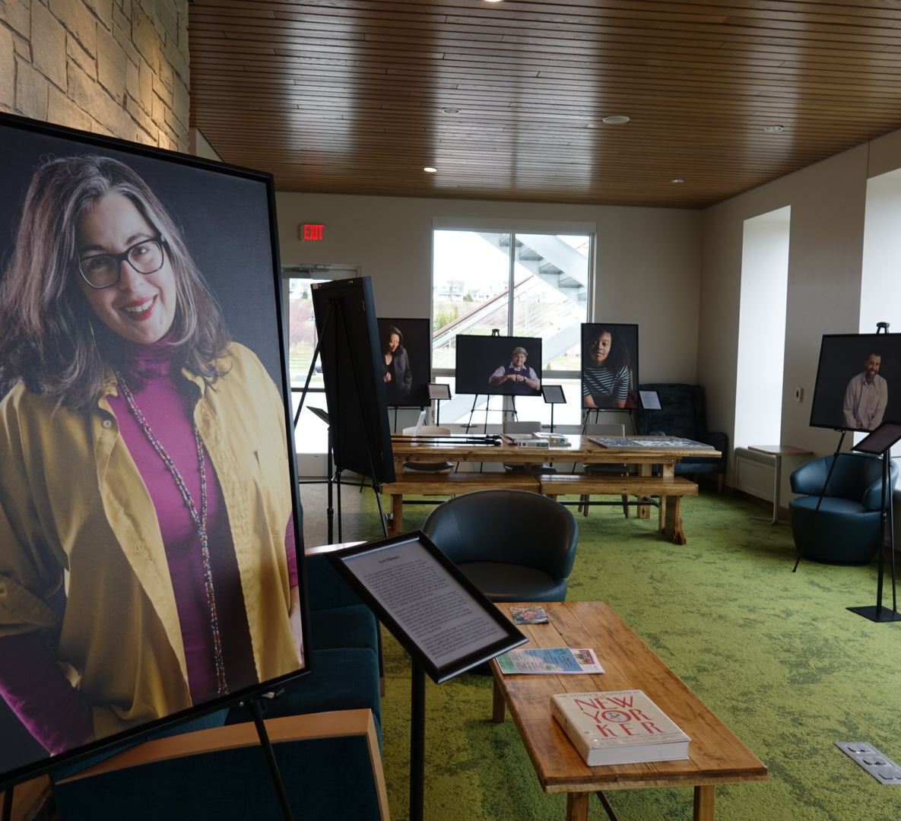
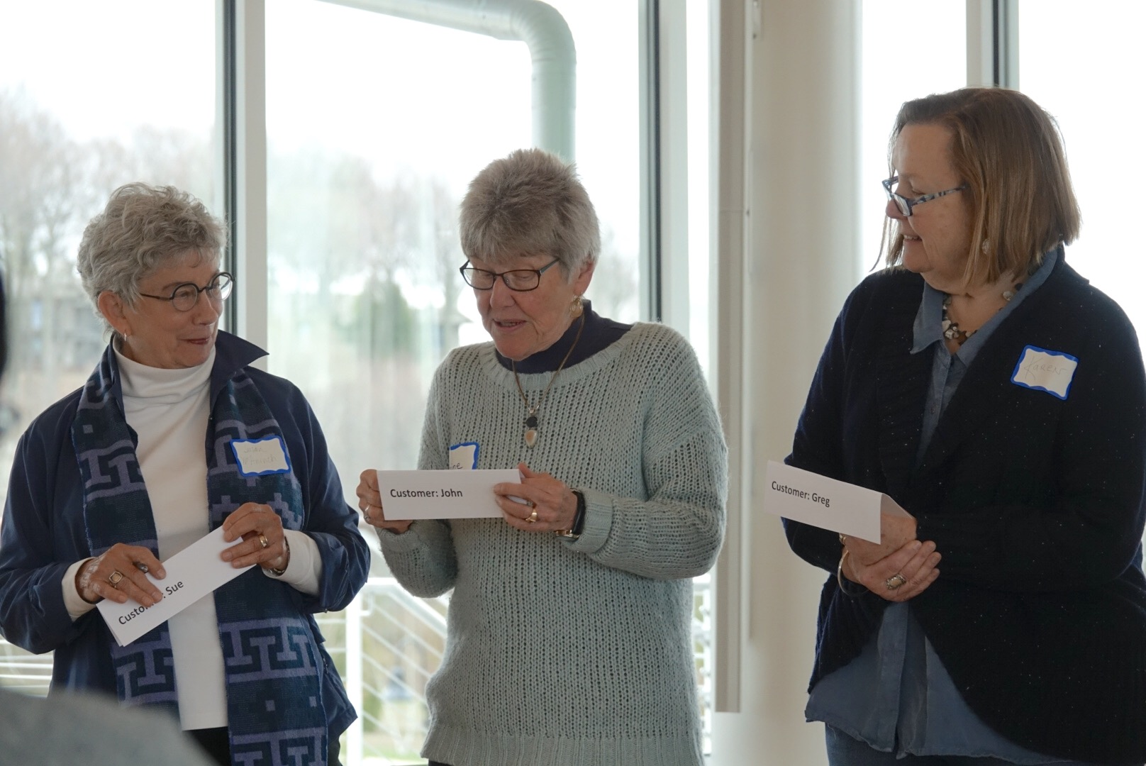
COLOR-BRAVE PhOTo PROJECT
Bystander/upstander workshop

Slide 28
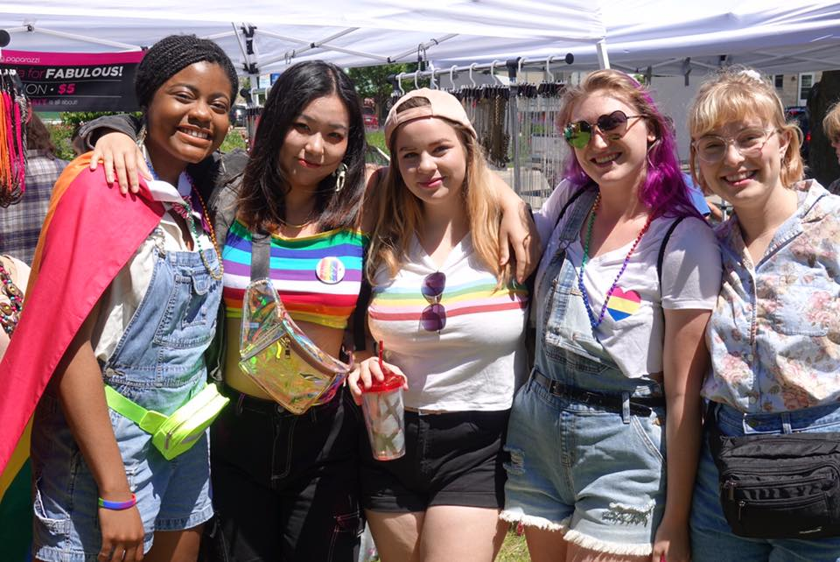
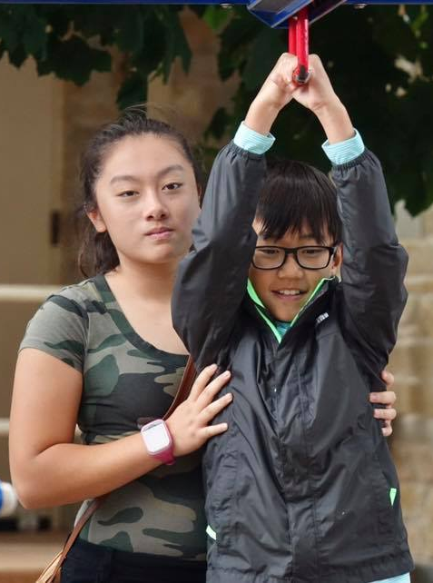
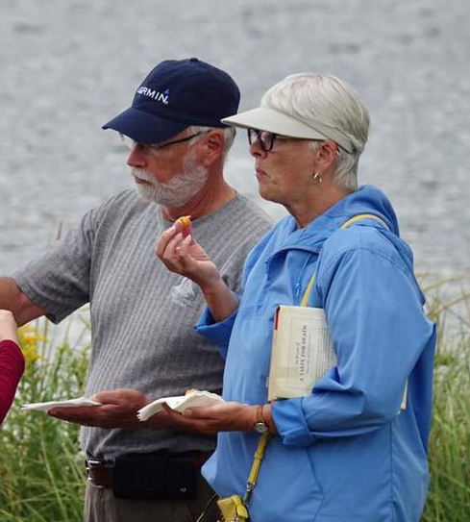
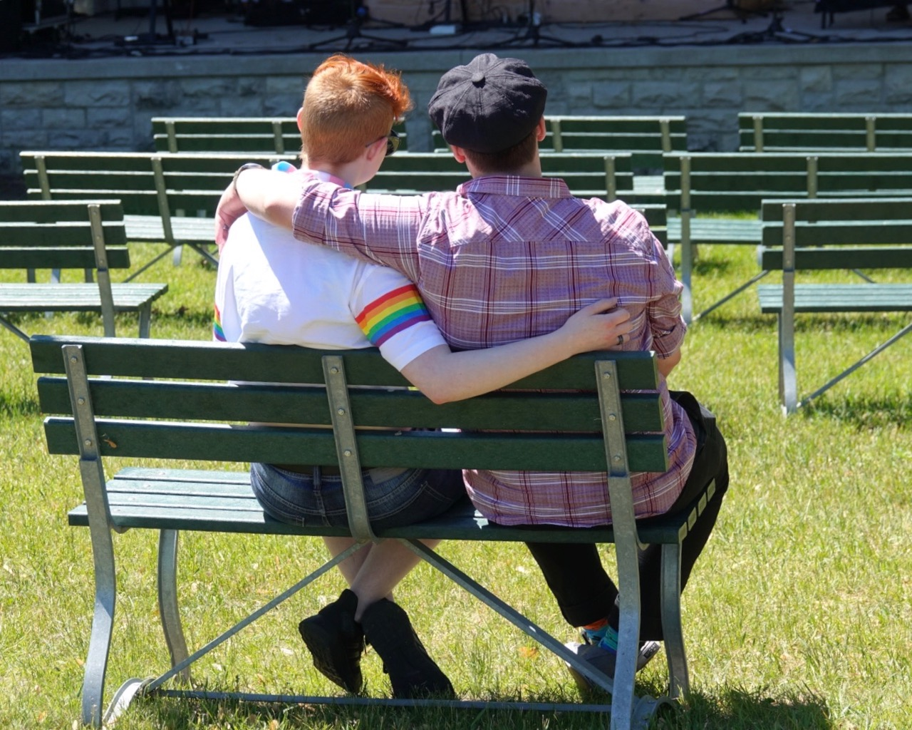
Practicing intentional INCLUSION
Evaluate your organization ‘s strengths/weaknesses in inclusion
Identify specific inclusion goals & timetable for implementation
Designate an inclusion point-person
Collaborate with others for ideas, programming, and mentorship

