Slide 1
Boys & Girls Club 6 – 4 - 14
A community-based initiative that advances
the cause of civility in everyday life to
strengthen our shared community.

Slide 2
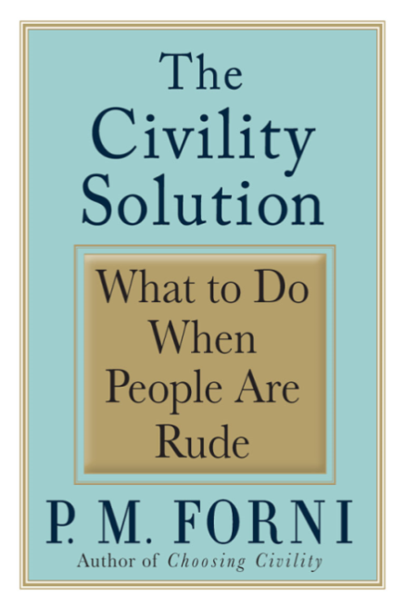
Why civility?
Civility provides a safe ‘space and means’ for people to talk and learn from each another about shared issues.
Civility is not simply a display
of manners, it is a mind-
set.

Slide 3
The Door County Civility Project…
I
Is NOT a campaign to end all disagreements …
but a campaign to make it safe to disagree.
Is NOT about perfection…
it is about making a conscious commitment to
actively pursue improvement.

Slide 4
Speak Your Peace – The Nine Tools of Civil Behavior
Insert our poster
“It’s not what you say but how you say it” is a classic statement.
The DC Civility Project believes civility is both –what you say AND how you say it! Recognize the power of your words!

Slide 5
1. Pay Attention
Every act of kindness is first of all, an act of attention.
Avoid automatic pilot; you are not attending just to a person, but this person.
Sharpen your antenna!

Slide 6
Attending …
How do you check your own attending behaviors?
*Inward - Are you noticing your own reaction?
… take 3 deep breaths
*Can you be texting, on the computer, answering a cell phone and still be attending to the person speaking to you?
*Outward - Are you with speaker here
and now and not lost in your own
judgments or agenda?
… smiling facilitates connection
* Brains come to a conclusion 55 % based on how a person looks, 38% on how a person sounds and 7 % on the actual words
What if you feel you are not being attended to by someone you are communicating with?
Sample response:
“You seem distracted (busy). Is there another time we might talk? This is important to me?”
What if you have a good reason for not attending?
Sample responses:
“ I have a report due in 20 minutes. Can we talk after that so I can give you my full attention?”
“I have only 10 minutes available now, if this will take more time can we schedule a time to talk?”
How do we show kids we are attending to them? How do we encourage them to attend to us? To one another?

Slide 7
2. Listen
Much of the conflict in our lives can be explained by one simple but unhappy fact: we don’t really listen to each other.

Slide 8
Listening…
If you find yourself…
*constantly interrupting
*zoning out
*finishing a person’s sentence
*formulating your response before they are finished
*changing the subject at will
*focusing on what you want from that person (a job, how much money they make)
*eavesdropping on nearby conversations
… you’re not in listening mode.
You can’t be listening when you’re talking!!
How do we let others know we are listening?
*Body language… nodding,
affirming, and intently following
*Repeat what you’ve heard prior to responding…
Sample responses:
“This is what I hear you saying… is it what you meant?”
“Tell me how you came to this understanding?”
“How did you come to believe this?”
How do we encourage good listening among children?

Slide 9
3. Be Inclusive
Diversity of people, thoughts, opinions, and ideas, help us achieve a broader dimension of ourselves as individuals and communities.
Remember to “Invite the Stranger.”

Slide 10
Inclusiveness…
Do you demonstrate inclusive behavior?
Our neighborhoods, churches, service clubs, etc., constantly having new folks. Do we make an effort to welcome and get to know them?
Do we have to Like everybody? No… but we can make an effort to respect one another and do no harm to those we may “like less”.
What if you are excluded?
How do we step forward ourselves when we might be the one with different views, ideas, experiences?
How do you encourage children to include others?

Slide 11
4. Don’t Gossip
Don’t discount the power of your words.
Speaking with consideration and kindness is at the heart of civil behavior.
“Nobody ever gossips about other people’s secret virtues." – Bertrand Russell

Slide 12
Gossip…
How do you check your own temptation to gossip?
Is it from a truly thoughtful, helpful place, or is there another intention?
Ask yourself…
Is it kind?
Is it true?
Is it necessary?
How do you respond if you feel someone is gossiping to you?
Do you…
*remain silent
*leave
*say something positive about the person being discussed
*change the subject
*directly say you don’t want to talk about the person not present
Sample response:
“But that’s just a rumor, right?”
How do you respond when you overhear children gossiping about one another?

Slide 13
5. Show Respect
Honor other’s time and physical space.
Respect includes recognizing that others are entitled to look at the world differently.
Recognize and honor other’s good intentions.

Slide 14
Respect…
How do you express your different view without alienating another person?
*Present your opinions as just opinions, not truths
*Try for a qualified disagreement
Sample response:
“Yes, but if you look at it from a different point of view…”
*Ask “What do you think?”
*Know when to hold your tongue!
How do you respond if someone treats you in a disrespectful manner? SIR technique
State the facts
“When you called attention to my weight gain…”
Inform the other person how you were impacted by their actions
“…I was embarrassed and hurt…”
Request that hurtful behavior not be repeated
“… please do n’t make that kind of comment when we are with others.”
Can this technique work with children?

Slide 15
6. Be Agreeable
Two key ingredients for being agreeable in conversation:
* The ability to consider
that you might be wrong.
*The ability to admit that
you don’t know.
“To disagree, one doesn’t have to be disagreeable.”
- Barry Goldwater

Slide 16
Being agreeable…
How to you check your own “agreeable” attitude?
Are you genuinely prepared to discuss points of view and alternatives with a willingness to compromise or are you on a crusade to win at all costs?
Do you want to thoughtfully resolve the issue or do you want to crush the other party?
*Try listening for understanding prior to speaking.
*Look for ‘some” possibilities for agreement
*You can say almost anything if you use a neutral tone.
What if someone you are communicating with seems to be “unagreeable?”
*Choose your battles… what battles NEED to be fought?
*Keep the discussion fact-based.
*Re-frame destructive statements into constructive ones, focusing on the source of the disagreement rather than blaming the other person.
How do you work with kids who are often seem “edgy”?

Slide 17
7. Apologize
It is courageous and humbling to admit fault.
Be genuine and your message heartfelt.
Three parts:
“I’m sorry for…
It’s my fault
What can I do to make it
right?”

Slide 18
Apologies and Forgiveness…
Insincere…
*Vague or incomplete acknowledgement… “I’m sorry for whatever I did.”
*Passive voice… “Mistakes have been made.”
*Conditional… “If mistakes have been made…”
*Minimizing… “There’s really nothing for which to apologize.”
*”I’m sorry you’re angry with me.”
A sincere apology acknowledge personal wrong doing and works at repairing damage.
Sample:
“I apologize for… (what I did) and am sorry for hurting you. What do you need in order to move on?’
THEN find a way to make it better!
It is never to late to apologize!
How do we encourage the development of empathy in children which may lead them apologies and forgeiveness?
UW psychologist Robert Enright Forgiveness is a Choice

Slide 19
8. Give Constructive Criticism
Human beings are fallible.
Sharing an opposing point of view is a civic responsibility--
“If not I, who?
If not now, when?”
Intention must be to help, not to humiliate.

Slide 20
Constructive criticism…
How do you check whether your comment is constructive?
*Is the purpose to create awareness that can lead to correction or improvement.
*How to offer constructive criticism:
Identify the issue, don’t attack the person; stick to the problem… we solve problems not people.
Describe what you heard or saw – don’t use generalizations
Suggest a solution
Stay positive and attentive; avoid personal attacks.
Can you accept constructive criticism?
*When people offer you criticism, listen – it may be a learning opportunity!
How do we help children accept feedback?
What if criticism is out of line and done in poor taste?
*Give a simple 1-2 liner response, one that acknowledges receipt of the comment but doesn’t engage further in the discussion.
*Choose not to accept or engage in their negativity!
*Don’t feed the trolls!
*Take the high road!

Slide 21
9. Take Responsibility
Don’t pretend something didn’t happen; own your behavior.

Slide 22
Taking responsibility…
Do you take responsibility for your actions?
*No one is perfect, nor will we ever be perfect.
*”We’ve always done it this way” is not necessarily a good thing.
How do you respond to someone not willing to take any responsibility?
*Recognize the difference between right and wrong and have the strength of your moral convictions to stand up, speak out, and act.
How do we encourage the young people we work with to take responsibility for their actions?

Slide 23
What Can You Do?
Individually commit to civility (sign the pledge) and model civil behavior.
Post the Door County Civility posters on your refrigerator and in your work place.
Model civil behavior - Use the language of Speak Your Peace as you interact with young people and colleagues.
Ask other groups of which you are a member to endorse civility and promote the use of the tools of civility.

Slide 24
Just Say YES to Civility!
Website: DoorCountyCivilityProject.org
WisconsinCivilityProject.org
‘Like’ us: Facebook “DC Civility Project”
Email: dccivilityproject@gmail.com

